Slide 1


Medic Helper

Slide 2
Team Introduction
Team members:
Md. Fazle Rabbi - 011161141
Md. Shakhawat Hossain - 011162067
Dihan Pathan - 011172050
Mahfuja Afroz - 011172054
Md. Samiul Haque Mahin - 011181034
Course Teacher :
MD. RAFI-UR RASHID
Lecturer,
United International University
1

Slide 3
Usability Heuristics(basis of our project)
Usability inspection method
Helps to identify usability problems
Main concern user interface (UI) design.

Slide 4
Consistency (Description)
In our project perspective following sequence and regularity(all of the pages follow same sequence)so basically this one is user friendly. Which is easier for all users.

Slide 5

Consistency
Use same interface
Maintain Using Sequence
Maintain Regularity

Slide 6
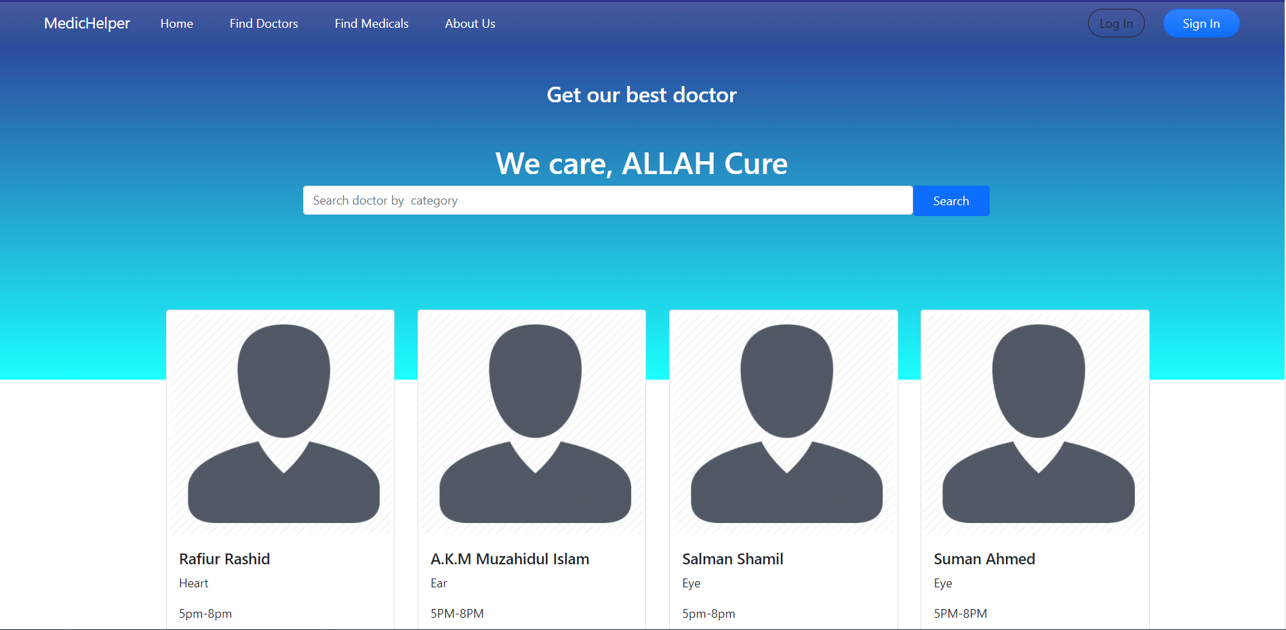
Consistency

Slide 7
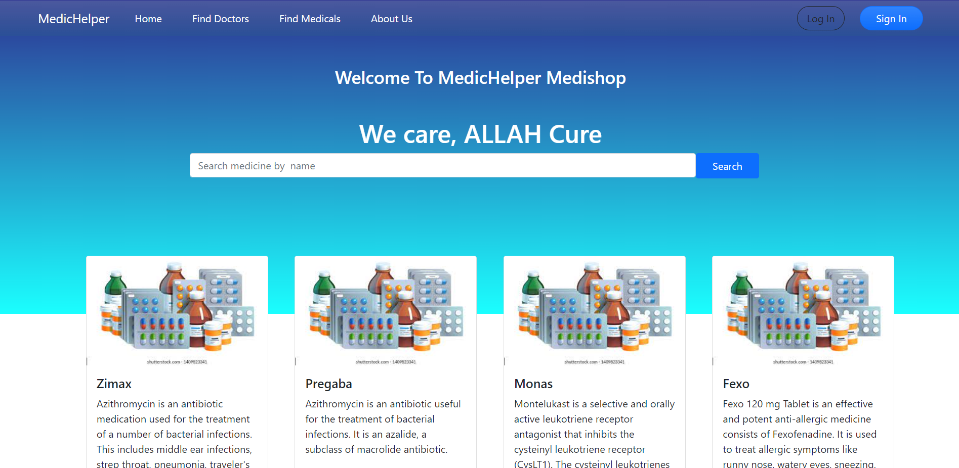
Consistency

Slide 8

Mapping
In this section basically in our project we used familiar user interface and used basic queries which is easier to understand for users.

Slide 9
Mapping
Familiar direction
Frequently used option

Slide 10
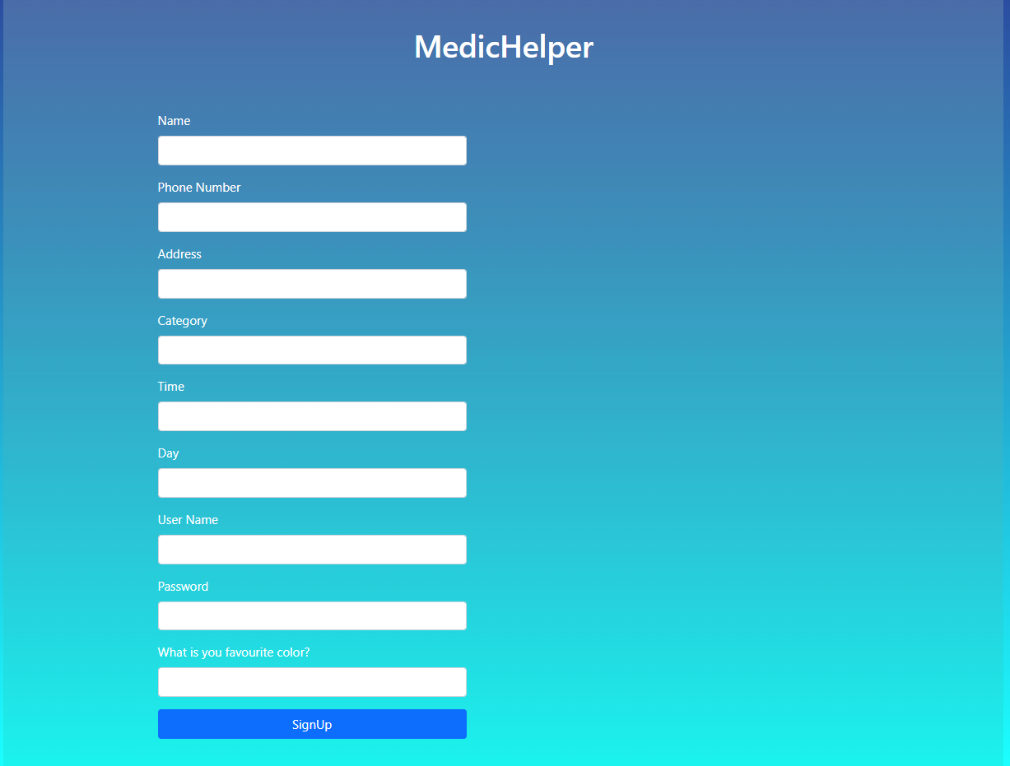
Mapping

Slide 11
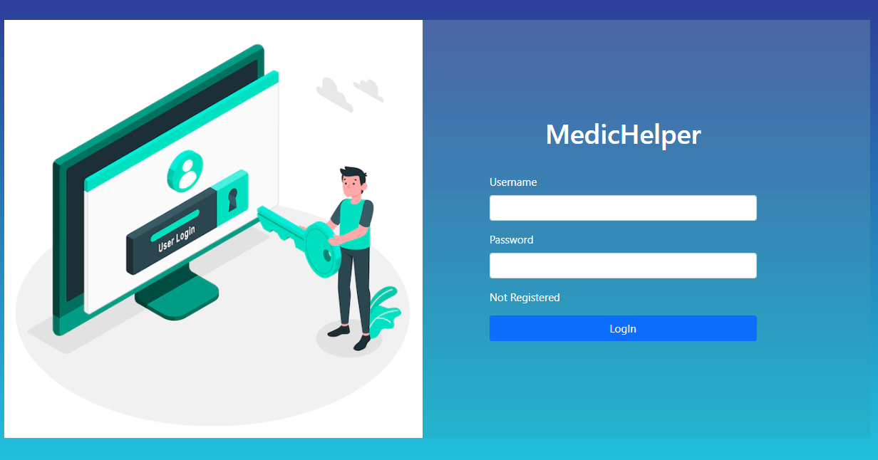
Mapping

Slide 12
Freedom
Users often perform actions by mistake. They need a clearly marked "emergency exit" to leave the unwanted action without having to go through an extended process.
Allows user to exit a flow or undo an action.
Allows to return system’s previous state.

Slide 13

Freedom

Slide 14


